Slide 1

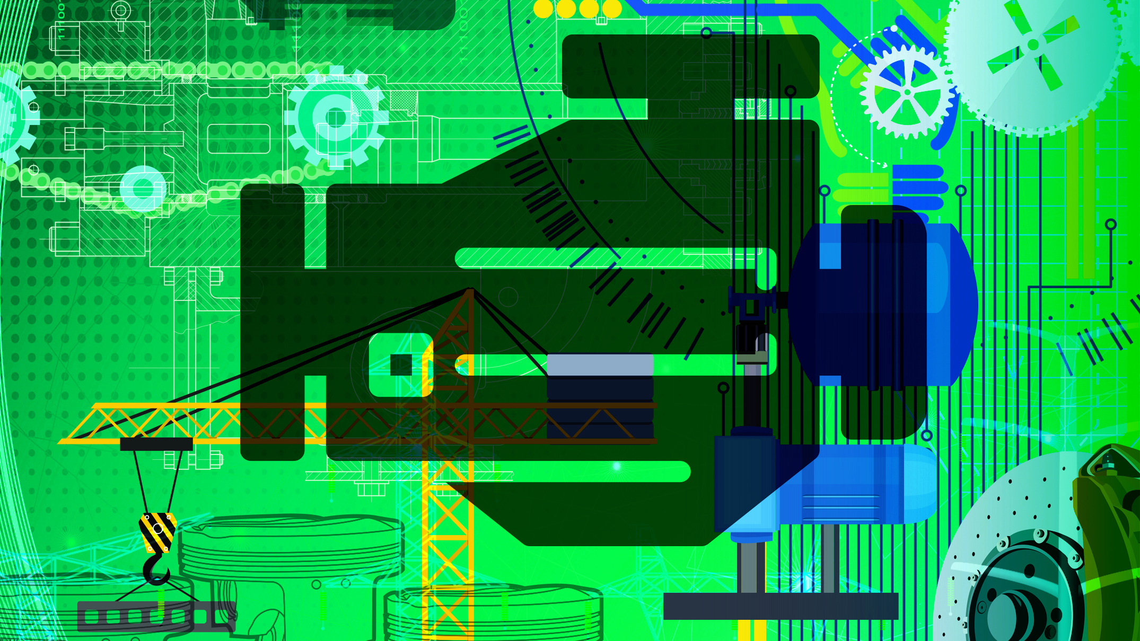
Mechanotechnology
N3

Slide 2
Module 1: Power transmission
BELT AND CHAIN DRIVES
Belt and chain drives are used to transmit torque from a driver to a driven shaft like on a bicycle where the pedals are connected to cranks that turn a driving gear at the front of the bicycle which is connected to the rear sprocket on the back wheel by a chain.
www.futuremanagers.com

Slide 3
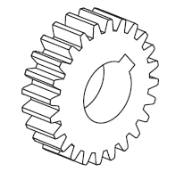
Module 1: Power transmission (continued)
GEAR DRIVES
Gears as a means of transmitting force and motion from one shaft to another are the number one choice in most cases, if the shafts are near enough to each other. Gears are the ideal means of changing the ratio in favour of power when needed.
www.futuremanagers.com

Slide 4
Module 1: Power transmission (continued)
COUPLING OF SHAFTS
There are different types of couplings which need to be identified, such as:
Permanent or fast couplings, such as Muff type couplings or flange type couplings.
Flexible couplings, such as pin type couplings or rubber type couplings.
Self aligning couplings, such as Oldham couplings or universal couplings.
www.futuremanagers.com

Slide 5
Module 1: Power transmission (continued)
CLUTCHES
There are different types of clutches which are suited to different designs:
Positive clutches, such as the claw clutch which absorbs shock and reduces noise and the spiral clutch which is like a ratchet.
Friction clutches, such as the multi-disc friction clutch used on power motor cycles or the cone clutch.
Centrifugal clutches which engage as soon as you accelerate.
Hydraulic clutches used on automatic gearboxes.
www.futuremanagers.com

Slide 6
Module 2: Brakes
THE PURPOSE OF BRAKES
The main function of a brake is to slow or stop rotation or linear movement when we, the operators, want or need to. A brake system is fitted to most vehicles firstly as a safety device and secondly to be able to adjust the rate of movement and to control the vehicle or machine to get the most work done as efficiently as possible. The brake system must be able to perform the following tasks instantly: in the case of a vehicle, it must be able to stop the vehicle within a given distance and time.
www.futuremanagers.com

Slide 7
Module 2: Brakes (continued)
BRAKING SYSTEMS
The system that will be used to apply the brake system will probably be one of the following:
Electro-magnetic brake units;
Hydraulic brake systems;
Air operated brake systems;
Mechanically operated brake systems.
www.futuremanagers.com

Slide 8
Module 2: Brakes (continued)
ADVANTAGES AND DISADVANTAGES OF ELECTRO-MAGNETIC BRAKING SYSTEMS
Advantages: Quick, automatic response to power cuts and other unexpected
complications. Very little maintenance is required under normal conditions. It offers a safe and secure environment.
Disadvantages: There must be a constant and reliable supply of electricity. This brake system is either on or off and can therefore not be used to slow a vehicle down at a rate that you as driver can control.
www.futuremanagers.com

Slide 9
Module 2: Brakes (continued)
ADVANTAGES AND DISADVANTAGES OF HYDRAULIC BRAKING SYSTEMS
Advantages: It prevents wheel lock up and can help with monitoring the handling of the vehicle and adjusting the conditions of the situation. It is also a simple system.
Disadvantages: The brakes can feel spongy and become less effective when air enters the system. The brake fluid needs to be changed at least once a year.
www.futuremanagers.com

Slide 10
Module 2: Brakes (continued)
ADVANTAGES AND DISADVANTAGES OF AIR BRAKING SYSTEMS
Advantages: The system is highly adaptable to the incorporation of additional units. There are no cables or connecting rods that require constant attention and rust protection. The system is very effective, powerful and reliable when correctly managed and well maintained.
Disadvantages: The vehicle must run for a while so that air pressure can build up. No air pressure no brakes. A burst pipe could lead to an accident if you need to brake at high speeds.
www.futuremanagers.com

Slide 11
Module 2: Brakes (continued)
ADVANTAGES AND DISADVANTAGES OF MECHANICAL BRAKING SYSTEMS
Advantages: This is the most simple system and is ideal for stationary rotating machinery. There are few parts, simple to assemble or strip, maintain and operate. No electric power is needed to operate them so they are not affected by power breaks or shedding.
Disadvantages: Human power is required, making it susceptible to human error. It has many cables which need constant cleaning and attention.
www.futuremanagers.com

Slide 12
Module 2: Brakes (continued)
ADVANTAGES AND DISADVANTAGES OF DISK BRAKING SYSTEMS
Advantages: Disc brakes are the ideal setup for light, powerful and fast motor vehicles. One can apply maximum pressure on the brakes without the danger of bursting the drum. It is open to air rushing past to cool the system, it is also self-adjusting.
Disadvantages: Disc pads wear away quickly and can get very hot under heavy breaking, so wheel bearings must be designed to handle this heat.
www.futuremanagers.com

Slide 13
Module 2: Brakes (continued)
ADVANTAGES AND DISADVANTAGES OF INTERNAL DRUM AND SHOE BRAKING SYSTEMS
Advantages: It is compact with components enclosed in the drum, which protects the brake shoes. It is fitted with an automatic adjusting device. A cable hand brake device is included in the drum.
Disadvantages: It does not deal well with heat and loses efficiency quickly. The brake shoes limit the pressure that can be applied. The drum needs replacing often.
www.futuremanagers.com

Slide 14
Module 2: Brakes (continued)
ADVANTAGES AND DISADVANTAGES OF EXTERNAL DRUM AND BAND BRAKING SYSTEMS
Advantages: Adjustment to worn shoes can be done more easily. Brake dust and unwanted moisture are thrown off during rotation. Inspection can be done without having to strip or open anything.
Disadvantages: It has no automatic adjustment system and must be regularly adjusted by hand. Wear of the band and drum is high and requires regular replacement. The moving parts outside make it a dangerous area.
www.futuremanagers.com

Slide 15
Module 2: Brakes (continued)
ADVANTAGES AND DISADVANTAGES OF CONE BRAKING SYSTEMS
Advantages: Its shape requires much less force to apply it effectively. The cone shape works like a wedge and the less the taper the less force needed as the opposing surfaces are almost parallel.
Disadvantages: Has limited application and is not suitable for vehicles. It is better suited to clutches than brakes. Becomes less effective when the surfaces of the working systems become glazed.
www.futuremanagers.com

Slide 16
Module 3: Bearings
FRACTION BEARINGS/PLAIN BEARINGS
Friction bearings are also known as a bush, solid or plain bearings. The simplest form of a solid bearing is a cylinder with an inner hole. Because plain bearings are relatively inexpensive and simple, they are widely used. They operate on the principle of sliding friction and because of the friction between the two surfaces, the shaft and the hole; we use a lubricant to separate the surface of the bearing from the surface of the shaft.
www.futuremanagers.com

Slide 17
Module 3: Bearings (continued)
ANTI-FRICTION BEARINGS (ROLLING ELEMENT BEARINGS)
Anti-friction bearings are also called rolling element bearings which are a class of bearings that have become an indispensable part of most modern industrial machines. Plain bearings have sliding contact and rolling bearings have rolling contact. This rolling movement reduces friction much more than a friction bearing. Anti-friction bearings come in two basic types – ball or roller – which differ in the shape of the rolling element and the type of contact they exhibit.
www.futuremanagers.com

Slide 18
Module 3: Bearings (continued)
FACTORS THAT HAVE A DETRIMENTAL EFFECT ON ANTI-FRICTION BEARINGS
Factors that must be avoided because they cause bearing failure can be narrowed down to three categories namely:
Overheating;
Excessive noise; and
Excessive vibration.
www.futuremanagers.com

Slide 19
Module 3: Bearings (continued)
BEARING FAILURE AND HOW TO PREVENT IT
To prevent premature failing of bearings, operators should ensure proper care when working with bearings. This means paying careful attention to: Cleaning bearings and using good materials which won’t attract dust and lint.
Also ensure that you protect and store the bearings safely and securely. Make sure you do not overheat or use a hammer on the bearing.
www.futuremanagers.com

Slide 20
Module 3: Bearings (continued)
SELECTION OF THE CORRECT TYPE AND SIZE OF BEARING USING A MANUFACTURER’S CATALOGUE
When selecting the correct type and size of bearing using a manufacturer’s catalogue, the following basic factors are important:
Nominal outside diameter;
Nominal bore diameter;
Width;
Basic dynamic load;
Basic static load; and
Bearing number.
www.futuremanagers.com

Slide 21
Module 4: Water pumps, cooling and lubrication
WATER PUMPS
Water pumps have two main categories, namely reciprocating pumps (also referred to as positive displacement pumps) and rotary pumps (otherwise known as non positive displacement pumps).
www.futuremanagers.com

Slide 22
Module 4: Water pumps, cooling and lubrication (continued)
COOLING
The need for cooling is paramount and directly proportional to the effective life span of any engine and must therefore receive primary attention when designing and or operating these engines. There are two major groups into which we divide cooling systems, namely: direct air cooling and indirect air cooling.
www.futuremanagers.com

Slide 23
Module 4: Water pumps, cooling and lubrication (continued)
LUBRICATION
Lubricants come from four main sources, namely: mineral crude oil, from plants such as sunflowers, animal oils such as from whales and today synthetic oils tailor-made to suit the requirements dictated by the function for which they will be used. Synthetic oils allow us to reach performances only dreamed about previously but, at a much higher price. Lubricants are divided into three basic groups: liquid, such as oil, semi-solid, grease, and solid form such as graphite, soap and white lead.
www.futuremanagers.com

Slide 24
Module 5: Hydraulics and pneumatics
HYDRAULICS
Hydraulic systems are systems that can transmit a force or movement via a fluid. They can be used as links between mechanical parts, thus eliminating the need for shafts, gears and connecting rods. Hydraulic systems:
Use fluid under pressure (blood of the system) to function.
Employ pumps, reservoirs, control valves, pressure tubes and cylinders or motors.
Are used in combination with other machinery for the purpose of control.
www.futuremanagers.com

Slide 25
Module 5: Hydraulics and pneumatics (continued)
PNEUMATICS
Work done by such a system may be done by means of a substance under pressure. The substance can be a gas, for example compressed air. A system that uses a gas for transmitting force is called a pneumatic system.
www.futuremanagers.com

Slide 26
Module 6: Internal combustion engines
BASIC OPERATION OF PETROL AND DIESEL FOUR-STROKE ENGINES
The basic operations can be broken up into the four strokes:
Stroke one: the inlet stroke.
Stroke two: the compression stroke.
Stroke three: the power stroke.
Stroke four: the exhaust stroke.
www.futuremanagers.com

Slide 27
Module 6: Internal combustion engines (continued)
FOUR-STROKE DIESEL ENGINES COMPARED TO THE FOUR-STROKE PETROL ENGINES
The diesel engine has the same four-strokes as the four-stroke petrol engine, the same order but with one difference, only air is drawn in during the inlet stroke, no fuel. The compression ratio is twice as high as that of the petrol engine. The diesel engine due to the higher compression ratio is more fuel efficient and produces more torque per litre engine capacity than the same size petrol engine.
www.futuremanagers.com

Slide 28
Module 6: Internal combustion engines (continued)
TWO-STROKE PETROL ENGINES COMPARED TO THE TWO-STROKE DIESEL ENGINE
The two-stroke petrol engine is usually used to power light, small capacity motor cycles, chain saws, weed-eaters and other such devices. These motors are usually simple, air cooled, light weight and easy to service. Two-stroke diesel engines are commonly very big stationary units..
These units are usually supplied with inlet air through a super-charger and have no inlet valves but at least two outlet valves per cylinder.
www.futuremanagers.com

Slide 29
Module 6: Internal combustion engines (continued)
ADVANTAGES AND DISADVANTAGES OF A TWO-STROKE PETROL ENGINE
Advantages: These motors are very simple, light, cheap, air cooled, no oil pump or water pump. High revving with a very light flywheel, often only a pulley.
Disadvantages: This engine is suitable for use in small formats only, like a lawn mower or weed-eater. Does not produce high torque and cannot run for long if air-cooled.
www.futuremanagers.com

Slide 30
Module 6: Internal combustion engines (continued)
ADVANTAGES AND DISADVANTAGES OF A TWO-STROKE DIESEL ENGINE
Advantages: These motors are most effective in very large format like marine diesel engines. The engines have pressure feed lubrication which is brought up to pressure even before the motor starts to turn.
Inlet air is supplied by supercharges or turbines to improve volumetric efficiency. These engines are liquid cooled and can run continuously for days without overheating.
www.futuremanagers.com

Slide 31
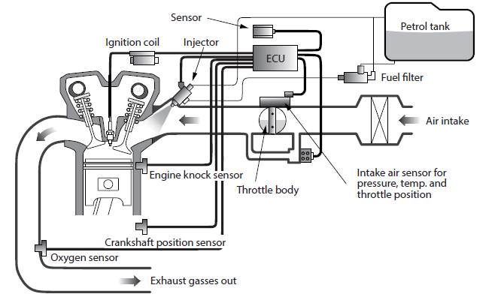
Module 6: Internal combustion engines (continued)
DIAGRAMMATIC LAYOUT OF A MODERN FUEL INJECTION SYSTEM FOR FOUR-STROKE PETROL ENGINES
www.futuremanagers.com

Slide 32
Module 6: Internal combustion engines (continued)
DIESEL ENGINES WHEN USED AS STATIONARY UNITS COMPARED TO PETROL ENGINES
Diesel fumes are darker and look worse but are less harmful to the environment and people with less carbon monoxide than petrol fumes. The diesel engine is safer in hazardous areas as there is no electric ignition system required. Diesel engines are inclined to be noisier than petrol engines. Petrol engines require regular maintenance in terms of time, while diesel engines require routine maintenance in terms of distance.
www.futuremanagers.com

Slide 33
Module 7: Cranes and lifting machines
INTRODUCTION
A crane is a type of machine that uses a collection of simple machines, generally equipped with a hoist rope, wire ropes or chains and sheaves, with at least one winder. These machines create mechanical advantage, which can be used to raise and lower objects or materials and to move them horizontally for a certain distance and then lower them at another point. It is mainly used for lifting heavy objects and transporting them to other places.
www.futuremanagers.com

Slide 34
Module 7: Cranes and lifting machines (continued)
THE PURPOSE OF CRANES
A crane is a machine that is capable of raising and lowering heavy objects and moving them horizontally. Cranes can also be used for the following functions:
To move the load vertical, up to the top of the building from ground level
To move the load in a horizontal manner within the radius the jib can turn
When fitted with wheels, to transport from one place (site) to another.
www.futuremanagers.com

Slide 35
Module 7: Cranes and lifting machines (continued)
TYPES OF CRANES
Overhead travelling cranes: Where the hook-and-line mechanism runs along a horizontal beam that itself runs along two widely separated rails.
Tower cranes: Widely used in the heavy construction and building industry.
Wharf cranes: Usually used for loading and unloading ships at dock.
Mobile cranes (with telescopic jibs): Usually fitted with adjustable angle and reach jibs. The crane itself is mounted on a chassis fitted with either tracks or four or more wheels.
www.futuremanagers.com

Slide 36
Module 7: Cranes and lifting machines (continued)
GENERAL SAFETY PRECAUTIONS WHILE OPERATING CRANES
Due to the large and heavy objects often being transported by cranes, routine inspections are necessary to ensure continued operation and crane safety. Crane training is required for all individuals who wish to operate a crane. A preventive maintenance programme with safety measures and precautions will prevent the majority of accidents.
www.futuremanagers.com

Slide 37
Module 7: Cranes and lifting machines (continued)
STEEL ROPES
A large choice of steel ropes is available.. The following should be considered when choosing a steel rope:
The size of the load to be lifted;
The length of each drop;
The number of drops;
Groove size on the drum or pulley; and
The velocity at which the rope will move.
www.futuremanagers.com

Slide 38
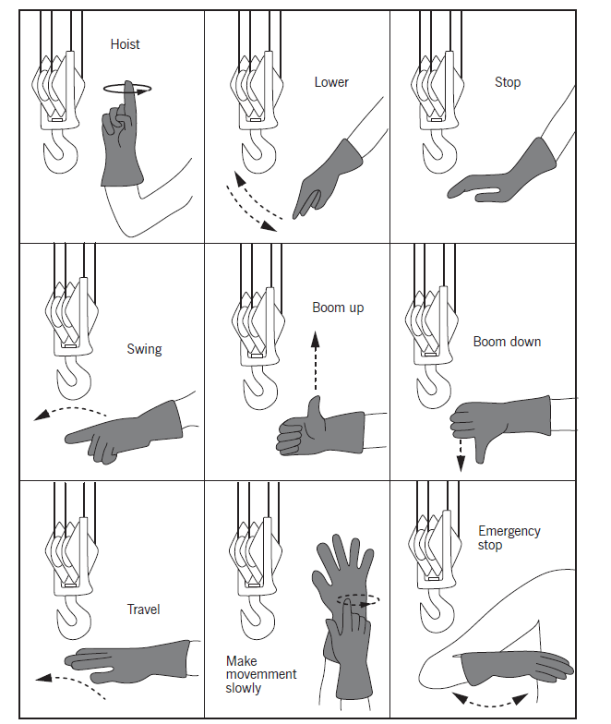
Module 7: Cranes and lifting machines (continued)
IDENTIFYING HAND SIGNALS
It is very important that the person on the ground giving the hand signals to the crane operator, called the signalman or slinger, is qualified and competent. The signalman and the crane operator must both understand the same set of hand signals.
www.futuremanagers.com

Slide 39
Module 8: Material and materials processes
METAL
The main ingredient in metal is iron. Metal is divided into two main groups, namely ferrous (containing iron) and non-ferrous (containing no iron) metals. Metals have the following properties:
Hardness;
Toughness;
Brittleness;
Ductility;
Malleability;
Tensile strength or tenacity;
Elasticity; and
Plasticity.
www.futuremanagers.com

Slide 40
Module 8: Material and materials processes (continued)
POLYMERS
Plastics are versatile materials that can be made to resemble and even replace material such as metal, wood, glass, ceramic, stone, fabric, rubber, glue, varnish and leather. When plastics are heated to a liquid or molten form, they can be moulded into almost any shape. When cooled they harden into a solid. There are two main groups of plastic materials: thermosetting plastics, also called thermosets, and thermoplastics.
www.futuremanagers.com

Slide 41
Module 9: Industrial organisation and planning
COMMUNICATION SKILLS
Communication in a business is important between personnel within the business. Supervisors and managers who are part of the industrial communication process have to move towards a style of communication in which communication has to become two-way, rather than one-way. Skills to communicate efficiently include: Listening for understanding, focusing on relaying the message and avoiding distraction, paying attention to interpersonal space, and being respectful.
www.futuremanagers.com

Slide 42
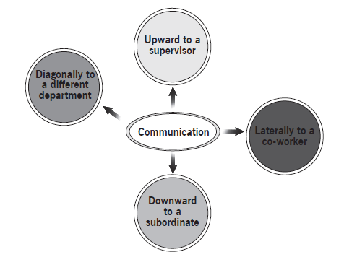
Module 9: Industrial organisation and planning (continued)
CHANNEL OF COMMUNICATION
An organisation’s structure usually influences the manner in which communication channels function. Information can flow vertically that is downwards and upwards, horizontally and diagonally:
www.futuremanagers.com

Slide 43
Module 9: Industrial organisation and planning (continued)
LABOUR RELATIONS ACT (NO. 66 OF 1995)
The Act is in place to advance economic development, social justice, labour peace and the democratisation of the workplace by promoting that:
Every person shall have the right to fair labour practices.
Workers shall have the right to form and join trade unions.
Employers shall have the right to form and join employers’ organisations.
Workers and employers shall have the right to organise collectively.
Workers shall have the right to strike for to do collective bargaining.
Employers’ recourse to lock-out for the purpose of collective bargaining shall not be impaired.
www.futuremanagers.com

Slide 44
Module 9: Industrial organisation and planning (continued)
SUMMARY OF THE OCCUPATIONAL HEALTH AND SAFETY ACT (NO. 85 OF 1993)
The Occupational Health and Safety Act became law in order to:
Provide for health and safety of people at work.
To ensure health and safety of people who are using plant and machinery.
To protect all people other than people at work, including the general public, against hazards to their health and safety arising out of or in connection with the activities of people at work.
Establish an advisory council for occupational health and safety.
Provide for matters with regards to occupational health and safety.
www.futuremanagers.com

Slide 45
Module 9: Industrial organisation and planning (continued)
ADMINISTRATION SYSTEMS
An administrative system is concerned with:
Bookkeeping;
The acquisition, storage and processing of information;
Cost accounting;
Statistics;
Archive control; and
General office organisation.
www.futuremanagers.com

Slide 46
Module 9: Industrial organisation and planning (continued)
PRODUCTION CONTROL DOCUMENTS
This document provides guidelines for a typical Factory Production Control (FPC) system. The processes and checks listed are not definitive or exhaustive. The purpose of this document is to assist with the creation of a Factory Production Control system that is appropriate for the organisation. The purpose of any Factory Production Control system is to control the manufacturing process systematically, within the boundaries.
www.futuremanagers.com

Slide 47
Module 9: Industrial organisation and planning (continued)
BUDGETING AND CONTROLLING EXPENSES
As a company’s capital needs and provision continually change, financial planning is one of the most important functions in a company. One of these control measures is the budget, which in the financial sphere is no more than a plan expressed in monetary terms for the activities of a particular period in the future. Budgets also deal with forecasting sales, without which no budgeting is possible.
www.futuremanagers.com

Slide 48
Module 9: Industrial organisation and planning (continued)
LABOUR EFFICIENCY
Labour efficiency is an integral part of your business, as it tells you how efficient your mechanics are, over time. It is also a key performance indicator (KPI) which defines how much of the technician’s time is spent working productively. Labour productivity measures the amount of goods and services produced by one hour of labour.
www.futuremanagers.com

Slide 49
Module 10: Entrepreneurship
ENTREPRENEURSHIP AND THE SMALL BUSINESS ENTERPRISE
Government, economists and even the person in the street appreciate the role that entrepreneurs play in creating employment opportunities and a higher standard of living for most people. Small businesses are primarily labour intensive and therefore they create more jobs than larger companies do. An entrepreneur usually focuses on small business enterprise, which is also known as a sole trader.
www.futuremanagers.com

Slide 50
Module 10: Entrepreneurship (continued)
ENTREPRENEUR PERSONAL CHARACTERISTICS AND QUALITIES
Some of the characteristics an entrepreneur should have in order to manage a business successfully:
Be action orientated;
High degree of drive and energy/philosophy of life;
High level of independence, self-confidence and persistence;
High level of determination and set goals consistently; and
Be ready and keen to take moderate, challenging risks.
www.futuremanagers.com

Slide 51
Module 10: Entrepreneurship (continued)
SELF-EVALUATION
An entrepreneur should answer questions about his/herself related to:
Energy, driving force and motivation;
Planning capabilities and organisational skills;
Ability to initiate and be creative;
Self-esteem and insight; and
Leadership capabilities and efficiency.
www.futuremanagers.com

Slide 52
Module 10: Entrepreneurship (continued)
GENERATING IDEAS
It is important to generate as many ideas as possible. These ideas can then be assessed to determine which of them will turn into business opportunities. Entrepreneurs are people who are always listening and looking around for business ideas. Ideas are gathered informally by reading newspapers and magazines, talking to friends and family and examining existing products and services. Entrepreneurs look for ways to satisfy consumers by improving existing products and services or producing new inventions.
www.futuremanagers.com

Slide 53
Module 10: Entrepreneurship (continued)
BUSINESS RESOURCES FOR THE SMALL BUSINESS ENTREPRENEUR
Small business entrepreneurs will find it difficult to succeed without the use of resources. The small business entrepreneur needs four resources to be successful:
Knowledge;
Skills;
Contacts; and
Funds.
www.futuremanagers.com

Slide 54
Module 10: Entrepreneurship (continued)
FACTORS WHICH INFLUENCE THE LOCATION OF A SMALL BUSINESS ENTERPRISE
One of the most important decisions a business has to make is where to locate. This can be determined by considering:
The type of business;
The nature of the products;
Competition;
Convenience and accessibility;
Symbiosis;
Expansion potential;
Service business; and
Manufacturing concerns.
www.futuremanagers.com

